Slide 1
Generative Models for Synthetic Data: A Deep Dive into the Gen AI Era
Transforming Data Mining in the GenAI Era
A Research Overview

Slide 2
The Data Problem
Real-world data is scarce and expensive to annotate
Privacy and proprietary concerns limit data sharing
Manual collection bottleneck slows AI progress
Solution: Generate synthetic data algorithmically

Slide 3
Three Engines of Synthetic Data
GANs
Competitive networks: Generator vs Discriminator
Diffusion Models
Iterative denoising: Add noise, then reverse
LLMs
Autoregressive: Predict next token/sequence

Slide 4
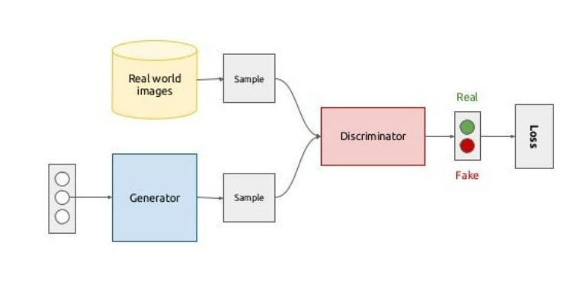
GANs: The Competitive Classics
Two networks compete: Generator vs Discriminator
Mode collapse limits diversity
Best for: Computer vision
Generator vs Discriminator Competition

Slide 5
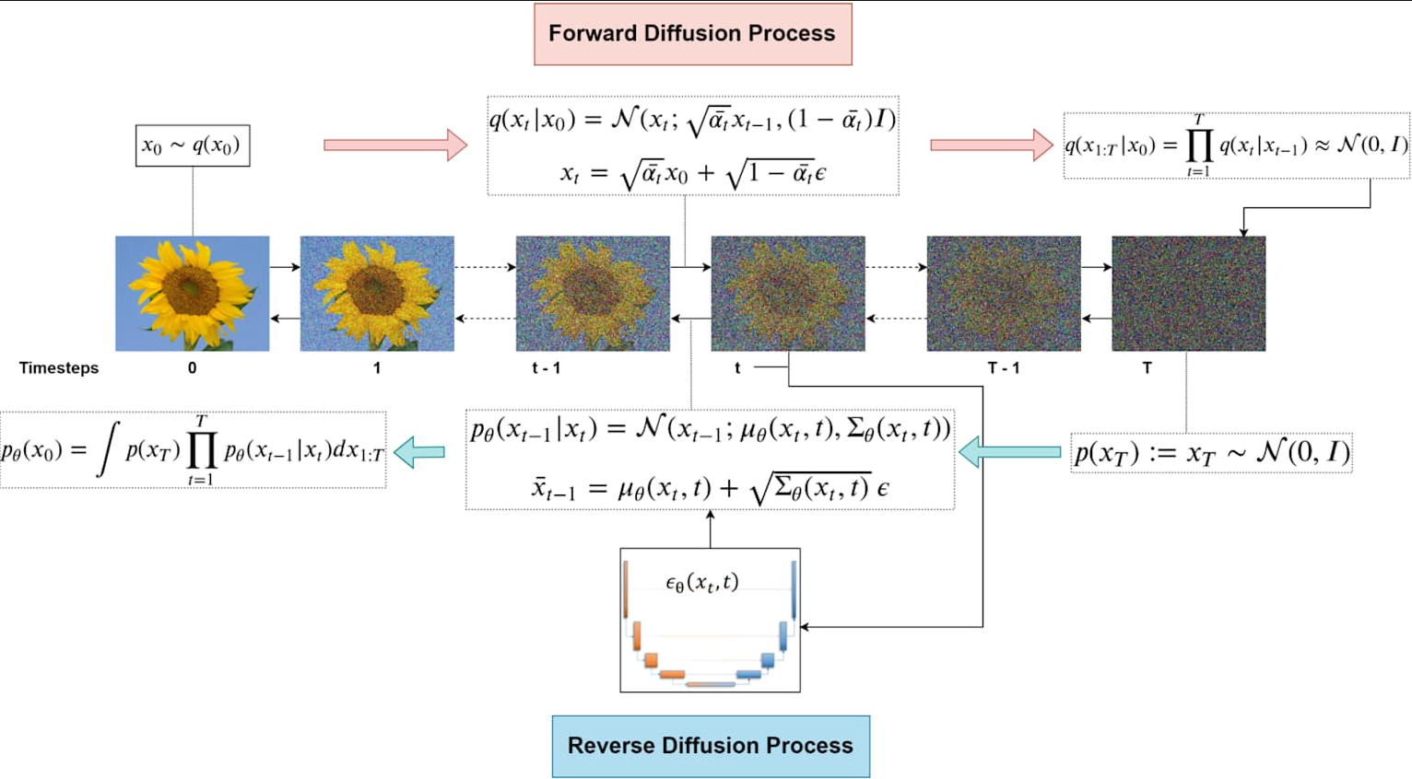
Diffusion Models: Forward & Reverse
Gradually add noise to data until random
Learn to reverse denoising process
More stable than GANs
Better diversity capture
DDPM: Forward Diffusion & Reverse Denoising

Slide 6
Text Synthesis: MagPie & DataGen
Two innovative approaches:
MagPie
Creates data from nothing - prompts LLM with templates, gets quality output
DataGen
Engineering approach with RAG validation, attribute guidance, quality control

Slide 7
Multimodal: Task-Me-Anything
Programmable system combining visual + text for specific tasks
AutoBench-V: Multi-agent loop with self-validation
Critical: Without self-validation, mismatches occur
Result: Honest benchmarking for large vision-language models

Slide 8
Generation Pipeline & Evaluation
End-to-End Synthetic Data Generation Pipeline
Fidelity: Match real data distribution | Utility: TSTR test
Privacy: DCR metric | Diversity: Full manifold coverage

Slide 9
Model Collapse: The Recursive Problem
Synthetic → Generate → Train = degradation
Rare events disappear
Biases amplified each iteration
Solution: Entropy injection (mix real data)

Slide 10
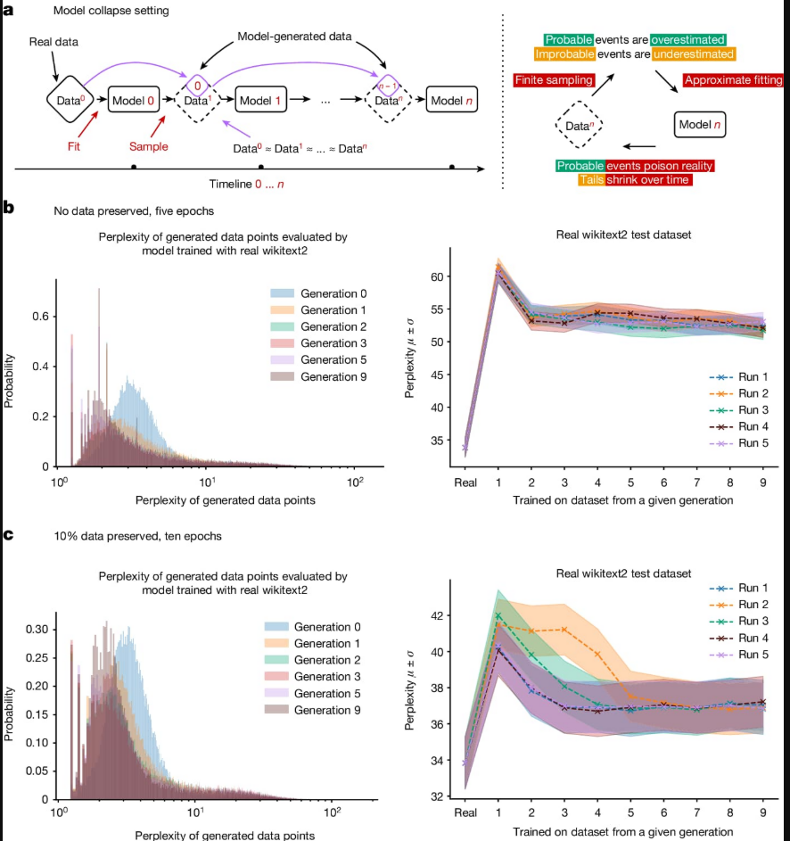

Slide 11
Real-World Applications
Healthcare
Synthetic clinical records (HIPAA compliance)
Finance
Fraud detection, transaction data, privacy-preserved
Education
Student performance predictions (data scarcity)

Slide 12
Benefits vs Challenges
Benefits ✓
Balance classes & remove bias
Privacy preservation (GDPR/HIPAA)
Simulate rare scenarios
Challenges ⚠
Miss real-world nuances
Learn spurious patterns
Model collapse risk

Slide 13
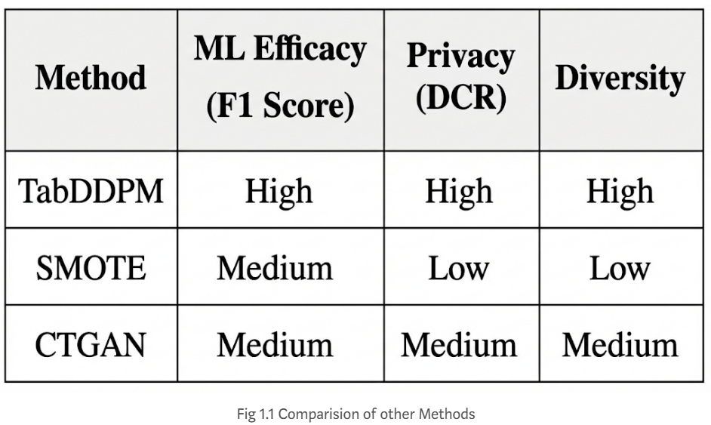
Research Tutorial Framework
Complete framework from generative models through applications

Slide 14
The Future of Data Mining
Data collection era → Data creation era (shift in progress)
Static test sets → Dynamic synthetic benchmarks
Focus on preventing model collapse through entropy injection
Bottleneck gone: Only limit is the questions we ask

Slide 15
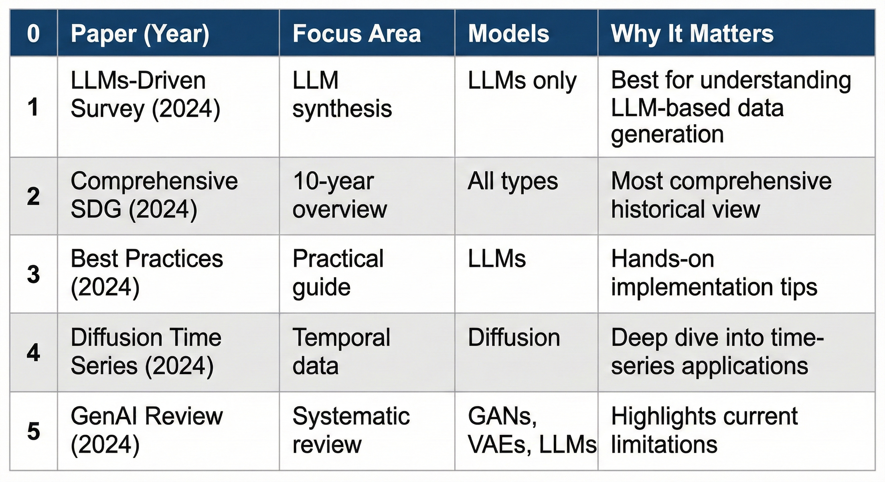
Research Landscape: Literature Review

Slide 16
References & Literature Review
Primary Source: Li et al. (2025). "Generative Models for Synthetic Data: Transforming Data Mining in the GenAI Era." ACM Tutorial.
Key Papers Covered:
Goodfellow et al. (2014). GANs - Generative Adversarial Networks
Ho et al. (2020). Denoising Diffusion Probabilistic Models
Rombach et al. (2022). Stable Diffusion - Latent diffusion models
Xu et al. (2024). MagPie - Alignment data synthesis from nothing
Huang et al. (2024). DataGen - Unified synthetic dataset generation
Kotelnikov et al. (2023). TabDDPM - Tabular data with diffusion models
Li et al. (2023). DiffuRec - Sequential recommendation with diffusion
Zhu et al. (2023-2024). DyVal - Dynamic evaluation for reasoning
Shumailov et al. (2024). Model collapse in iteratively trained models
Li et al. (2025). Synthetic Data Generation Tutorial - This research

